Slide 1

NSF EPSCoR and the Role of Cyberinfrastructure
Dr. Jennifer M. Schopf
National Science Foundation
EPSCoR Office
October 6, 2010

Slide 2
This talk will discuss how cyberinfrastructure is an essential component to support today's collaborative research. After a brief overview of the current NSF CyberInfrastructure for 21st Century Science (CF21) vision, we will examine how CI is playing a role in current EPSCoR programs and projects, and what role it may play in the future.
45 mins

Slide 3
Outline
CyberInfrastructure for 21st Century Vision
CyberInfrastructure within EPSCoR
  Networking
  Data Sharing
  Collaboration
Notes:
XX

Slide 4
Research Is Changing
Geographically distributed user communities
  Numerous labs, universities, industry
Integration with other national resources
  Inevitably multi-agency, multi-disciplinary
Extremely large quantities of data
  Petabyte data sets, with complex access patterns
  Also thousands of SMALL data sets
  None of it tagged as you need it, or in the right format

Slide 5

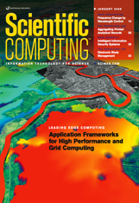
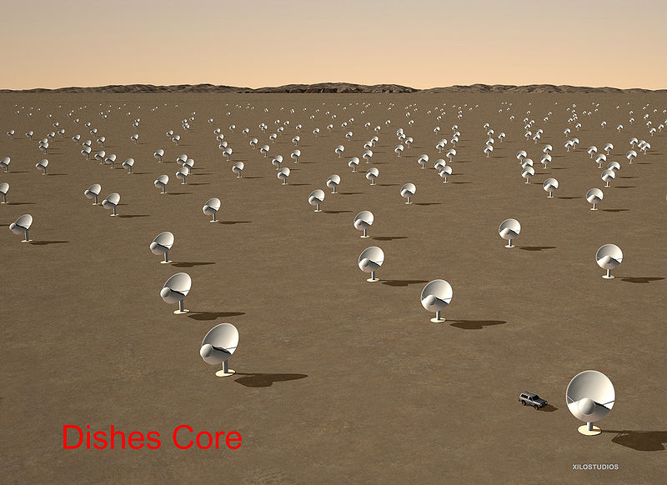

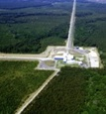
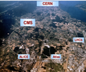
Framing the Question
Science has been Revolutionized by CI
Modern science
  Data- and compute-intensive
  Integrative
Multiscale Collabs
  Add’l complexity
  Individuals, groups, teams, communities
Must Transition NSF CI approach to address these issues

Slide 6
NSF Vision for Cyberinfrastructure
“National-level, integrated system of hardware, software, data resources & services... to enable new paradigms of science”
Learning & Work Force Needs & Opportunities
Virtual Organizations for Distributed Communities
High Performance Computing
Data & Visualization/ Interaction
http://www.nsf.gov/pubs/2007/nsf0728/index.jsp
Notes:
6
The NSF Cyberinfrastructure Vision for 21st Century Discovery describes the Foundation’s vision for the role of Cyberinfrastructure in facilitating scientific discovery and innovation. In chapter 3 on data, the Vision document says, “science and engineering digital data are routinely deposited in a well-documented form, are regularly and easily consulted and analyzed by specialists and non-specialists alike, are openly accessible while suitably protected and are reliably preserved.” In addition, “Scientific visualization, including not just static images but also animation and interaction, leads to better analysis and enhanced understanding.” A link to the Vision report is on the OCI home page.

Slide 7

What is Needed?
An ecosystem, not components…
NSF-wide CI Framework for 21st Century Science & Engineering
People, Sustainability, Innovation, Integration

Slide 8
CyberInfrastructure Ecosystem
Expertise
Research and Scholarship
Education
Learning and Workforce Development
Interoperability and ops
Cyberscience
Organizations
Universities, schools
Government labs, agencies
Research and Med Centers
Libraries, Museums
Virtual Organizations
Communities
Scientific Instruments
Large Facilities, MREFCs,telescopes
Colliders, shake Tables
Sensor Arrays
- Ocean, env’t, weather,
buildings, climate. etc
Discovery
Collaboration
Education
Data
Databases, Data reps,
Collections and Libs
Data Access; stor., nav
mgmt, mining tools,
curation
Computational Resources
Supercomputers
Clouds, Grids, Clusters
Visualization
Compute services
Data Centers
Networking
Campus, national, international networks
Research and exp networks
End-to-end throughput
Cybersecurity
Software
Applications, middleware
Software dev’t & support
Cybersecurity: access,
authorization, authen.
Sustain, Advance, Experiment

Slide 9



Cyberinfrastructure Framework for the 21st century (CF21)
High-end computation, data, visualization for transformative science
  Facilities/centers as hubs of innovation
MREFCs and collaborations including large-scale NSF collaborative facilities, international partners
Software, tools, science applications, and VOs critical to science, integrally connected to instruments
Campuses fundamentally linked end-to-end; grids, clouds, loosely coupled campus services, policy to support
People Comprehensive approach workforce development for 21st century science and engineering

Slide 10
ACCI
Task Forces
Data
(Viz)
Campus
Bridging
Dan Atkins
Tony Hey
Craig Stewart
Timelines: 12-18 months
Advising NSF
Workshop(s)
  Recommendations
Input to NSF informs
  CF21 programs
  2011-2 CI Vision Plan
Software
Computing
(Clouds
Grids)
David Keyes
Valerie Taylor
Thomas Zacharia
Education
Workforce
GC &
VOs
Alex Ramerez
Tinsley Oden

Slide 11
Preliminary Task Force (TF) Results
Computing TF Workshop Interim Report
  Rec: Address sustainability, people, innovation
Software TF Interim Report
  Rec: Address sustainability, create long term, multi-directorate, multi-level software program
GCC/VO TF Interim Report
  Rec: Address sustainability, OCI to nurture computational science across NSF units
Software Sustainability WS (Campus Bridging)
  Rec: Open source, use sw eng practices, reproducibility

Slide 12

CF21 Strategy
Driven by science and engineering
  Intense coupling of data, sensors, satellites, computing, visualization, grids, software, VOs; entire CI ecosystem
Better campus integration
Major Facilities CI planning
Task Forces and research community provides guidance and input
All NSF Directorates involved
Sustain, Advance, Experiment
12

Slide 13
EPSCoR and CI

Slide 14
EPSCoR Origins
NSF’s 1979 statutory authority “authorizes the Director to operate an Experimental Program to Stimulate Competitive Research (EPSCoR) to assist less competitive states” that:
  Have historically received little federal R&D funding; and
  Have demonstrated a commitment to develop their research bases and improve science and engineering research and education programs at their universities and colleges.

Slide 15
EPSCoR
Purpose/Objectives:
  Build research capacity and competitiveness
  Broaden individual and institutional participation in STEM
  Promote development of a technically engaged workforce
  Foster collaborative partnerships
Support state-wide programs

Slide 16
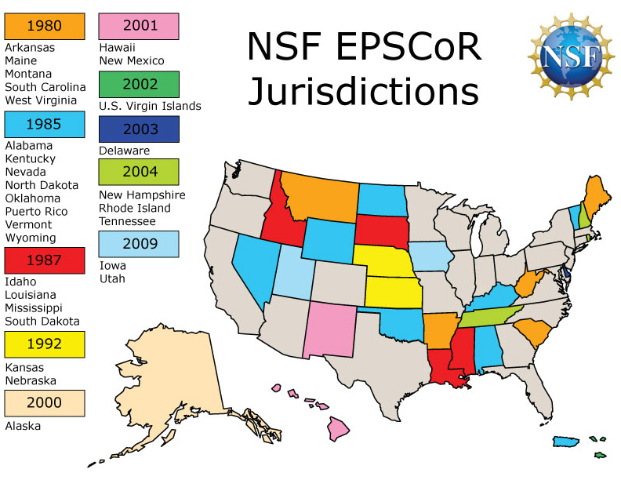

Slide 17
Stats: In the 29 Jurisdictions…
21% of the nation’s total population
24% of the research institutions
16% of the employed scientists and engineers
Receive about 12% of all NSF research funding.

Slide 18
Stats Cont.
22% of the nation’s African-Americans
36% of its American Indians, Alaskan Natives
31% of its Native Hawaiians, Pacific Islanders
16% of its Hispanics
52 of the nation’s 105 HBCUs (50%)
74 of the nation’s 257 Institutions with High Hispanic Enrollment (29%)
22 of the nations 32 TCUs (69%)
What an Opportunity for Leverage!

Slide 19
EPSCoR 2020
In 2006 workshop and follow-on report made a number of recommendations
  Refocusing for EPSCoR
  Vision for moving forward in the context of collaborative science
6 Recommendations
http://www.nsf.gov/od/oia/programs/epscor/docs/ EPSCoR_2020_Workshop_Report.pdf

Slide 20
Recc 1: More Flexible Research
Infrastructure and Improvement Awards
2008- Raised duration to 5 years
2009 – Raised funding to $4M per year
Additional programs were offered

Slide 21
Sub-Recommendation
Ensure that all EPSCoR jurisdictions have the CI necessary to attract and execute advance research
  Specifically to attract (and train) the next generation workforce

Slide 22
A Related Study:
Amy Apon, U. Arkansas
  “Demonstrating the Impact of High Performance Computing to Academic Competiveness”
Investigating correlation between
  University investment in CI
    In this case, was there a machine in the “Top 500”
  Research productivity measures
    NSF Funding, federal funding, publications, etc

Slide 23
Without HPC Investment
With HPC
Investment
Avg NSF funding: $30,354,000
Avg NSF funding: $7,781,000
FY06: 95 of Top NSF-funded
Universities with HPC
98 of Top NSF-funded Universities without HPC
Amy Apon, aapon@uark.edu

Slide 24
Caveats
Correlation not causation
Open question if these are the right things to measure
Dr. Apon herself says this is very preliminary
  But follow on work is fascinating
Another open question – how do we measure return on investment?

Slide 25
CI in EPSCoR
Networking
Data Sharing
Collaboration

Slide 26
Research Infrastructure Improvement Awards (RII)
Cyber Connectivity (C2)
Up to 2 years and $1M
Support inter-campus and intra-campus cyber connectivity and broadband
Across a EPSCoR jurisdiction
In FY10: 23 Props Rec’d; 17 Funded (ARRA)
In FY 11: 12 eligible jurisdictions

Slide 27
Networking can…
Support applications accessing remote data sources
Support educational opportunities
Support collaborations
SUPPORT SCIENCE!

Slide 28
Data Sharing
To support collaborations, cross- disciplinary, transformational research, curation of data is the keystone

Slide 29
Digital resources that are not properly curated do not remain accessible for long
Study | Resource Type | Resource Half-life
Koehler (1999 and 2002) | Random Web pages | 2.0 years
Nelson and Allen (2002) | Digital Library Object | 24.5 years
Harter and Kim (1996) | Scholarly Article Citations | 1.5 years
Rumsey (2002) | Legal Citations | 1.4 years
Markwell and Brooks (2002) | Biological Science Education Resources | 4.6 years
Spinellis (2003) | Computer Science Citations | 4.0 years
Source: Koehler W. (2004) Information Research, 9 (2), 174
Notes:
It is important that we move quickly. As this table suggests, digital resources that are not properly curated do not remain accessible for long. On the other hand, digital objects that are maintained in a digital library are likely to survive for decades.

Slide 30
Digital resources that are not properly curated do not remain accessible for long
Study | Resource Type | Resource Half-life
Koehler (1999 and 2002) | Random Web pages | 2.0 years
Nelson and Allen (2002) | Digital Library Object | 24.5 years
Harter and Kim (1996) | Scholarly Article Citations | 1.5 years
Rumsey (2002) | Legal Citations | 1.4 years
Markwell and Brooks (2002) | Biological Science Education Resources | 4.6 years
Spinellis (2003) | Computer Science Citations | 4.0 years
Source: Koehler W. (2004) Information Research, 9 (2), 174
Notes:
It is important that we move quickly. As this table suggests, digital resources that are not properly curated do not remain accessible for long. On the other hand, digital objects that are maintained in a digital library are likely to survive for decades.

Slide 31
Poor Data Practices
Time of publication
Specific details
General details
Retirement or
career change
Information Content
Accident
Death
Time
(Michener et al. 1997)

Slide 32
The Shift Towards Data
Implications
All science is becoming data-dominated
  Experiment, computation, theory
Totally new methodologies
  Algorithms, mathematics
  All disciplines from science and engineering to arts and humanities
End-to-end networking becomes critical part of CI ecosystem
  Campuses, please note!
How do we train “data-intensive” scientists?
Data policy becomes critical!
Notes:
XX keep?

Slide 33
Long Standing NSF Data Policy
“Investigators are expected to share with other researchers, at no more than incremental cost and within a reasonable time, the primary data, samples, physical collections and other supporting materials created or gathered in the course of work under NSF grants. Grantees are expected to encourage and facilitate such sharing.”
Has not been widely enforced, with a few exceptions like OCE
NSF Proposal and Award Policy and Procedure Guide, Award and Administration Guideline PDF page 61
http://www.nsf.gov/pubs/policydocs/pappguide/nsf10_1/aagprint.pdf

Slide 34
Changing Data Management Policy
IMPLEMENTATION
Planning underway for 2+ years within NSF
May 5, 2010 National Science Board meeting
  Change in the implementation of the existing policy on sharing research data discussed
Oct 1, 2010
  Change in the NSF GPG released
http://www.nsf.gov/news/news_summ.jsp?cntn_id=116928&WT.mc_id=USNSF_51
http://news.sciencemag.org/scienceinsider/2010/05/nsf-to-ask-every-grant-applicant.html

Slide 35
As of January 2011:
All proposals must include a data management plan
Two-page supplementary document
Can request budget to cover costs
Echos the actions of other funding agencies
  NIH, NASA, NOAA, EU Commission
http://www.nsf.gov/pubs/policydocs/pappguide/nsf11001/gpg_index.jsp

Slide 36
Guidelines will be
Community Driven
Avoid a one-size-fits-all approach
  Different disciplines encourage the approaches to data-sharing as acceptable within those discipline cultures
Data management plans will be subject to peer review, community standards
  Flexibility at the directorate and division levels
  Tailor implementation as appropriate
Request additional funding to implement their data management plan

Slide 37
Several recent programs have included preliminary requirements
Arctic Research Opportunities (OPP) 10-503
http://www.nsf.gov/pubs/2010/nsf10503/nsf10503.pdf
Macrosystems Biology (BIO) 10-555
http://www.nsf.gov/pubs/2010/nsf10555/nsf10555.pdf
Ocean Acidification (GEO/OPP/BIO) 10-530
http://www.nsf.gov/pubs/2010/nsf10530/nsf10530.pdf
Basic Research to Enable Agricultural Development(BREAD) (BIO) 09-566
http://www.nsf.gov/pubs/2009/nsf09566/nsf09566.pdf

Slide 38
DMP may include:
Types of data, samples, physical collections, software, curriculum materials, and other materials
Standards to be used for data and metadata format and content
  Say where existing standards are absent or deemed inadequate
Policies for access and sharing
  Protection of privacy, confidentiality, security, intellectual property, or other rights or requirements
Policies and provisions for re-use, re-distribution, and the production of derivatives
  Citation reference
Plans for archiving data, samples, and other research products, and for preservation of access to them

Slide 39
DMP cont.
DMP may include only the statement that no detailed plan is needed
  Statement must be accompanied by a clear justification
DMP will be reviewed as an integral part of the proposal, coming under Intellectual Merit or Broader Impacts or both, as appropriate for the scientific community of relevance

Slide 40
Directorate, Office, Program Specific Requirements
http://www.nsf.gov/bfa/dias/policy/dmp.jsp
If guidance specific to the program is not available, then the requirements in GPG apply
Individual solicitations may have additional requirements as well

Slide 41
One More Thing to Keep In Mind
This policy mandates that you have to make your data accessible
  Archive, open access, metadata tagged
This is actually the easy step
Getting the data out again, using other people’s data – a MUCH harder problem
  But not part of this work

Slide 42
Collaborations

Slide 43
Research Infrastructure Improvement Awards (RII) Track 1
Up to 5 years and $20M
Improve physical and human infrastructure critical to R&D competitiveness
Priority research aligned with jurisdiction S&T plan
In FY 2009: 9 Proposals Received; 6 Funded
In FY 2010: 14 Proposals Rcv’d; 7 Funded
In FY 2011: 7 eligible jurisdictions

Slide 44
Research Infrastructure Improvement Awards (RII) Track 2
Up to 3 years and $6M
Consortia of jurisdictions
Support innovation-enabling cyberinfrastructure
Regional, thematic, or technological importance to suite of jurisdictions
In FY 09: 9 Props Rec’d; 7 Funded (5 ARRA)
In FY10: 9 Props Rec’d; 5 Funded
In FY11: 6 eligible jurisdictions

Slide 45
Collaborations
Support the jurisdiction S&T plans
  Includes industry involvement
Support the jurisdiction CI plan
Support research and education across the jurisdiction
  Including community colleges, tribal colleges, PUI’s, and others
Support workforce development, external outreach

Slide 46
Research Is Changing
Geographically distributed user communities
  Numerous labs, universities, industry
Integration with other national resources
  Inevitably multi-agency, multi-disciplinary
Extremely large quantities of data
  Petabyte data sets, with complex access patterns
  Also thousands of SMALL data sets
  None of it tagged as you need it, or in the right format
EPSCoR and NSF are growing and changing to support new science

Slide 47
More Information
Jennifer M. Schopf
  jschopf@nsf.gov
  jms@nsf.gov
Dear Colleague letter for CF21
http://www.nsf.gov/pubs/2010/nsf10015/nsf10015.jsp

